Slide 1





Simple
Investment
People

Slide 2

Project Contributors
Amanullah Afzali
Amir Baseri
Jerry Hsieh

Slide 3
Mission and Vision
Choosing right stock to invest is a hard decision for many people. In this project our goal is to solve business problems rooted in the fintech subsegment of digital investment advisory. And to democratize access to tools that assist investors with diverse investment acumen. From novices to more experienced individuals.

Slide 4
Project Questions
Who is our target user?
How can we help everyday investors make smart investment decisions?
How can we help investors assess risk associated with certain investments in relation to the overall market?
How can we help investors predict the future value of their investment positions from a growth perspective?

Slide 5


Data Resources

Slide 6


Demo Stocks and Indexes
Stocks
Indexes
Apple
Amazon
Facebook
Tesla
Microsoft
Netflix
Walmart
DOWJ
NASDAQ
S&P500
VIX

Slide 7

Performance and Risk Analysis
DAILY RETURN
CUMULATIVE RETURNS
30 DAYS ROLLING STATISTICS
Beta
SHARP RATIOS

Slide 8
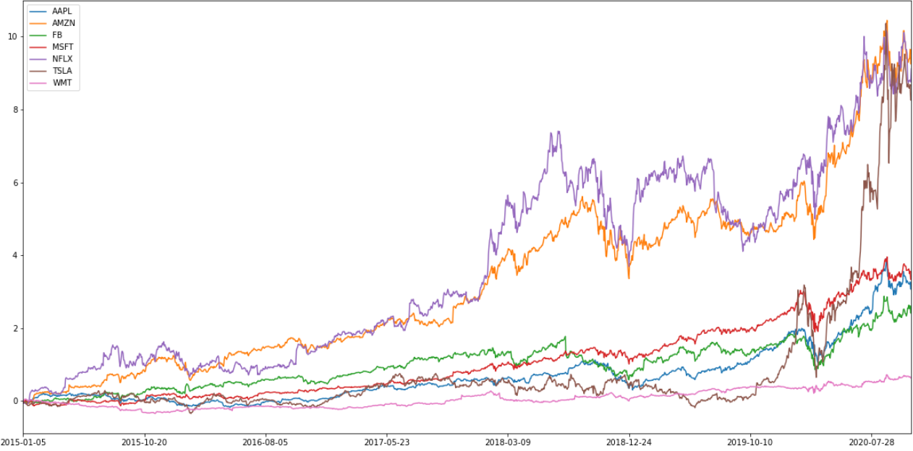

Stock Cumulative Returns

Slide 9
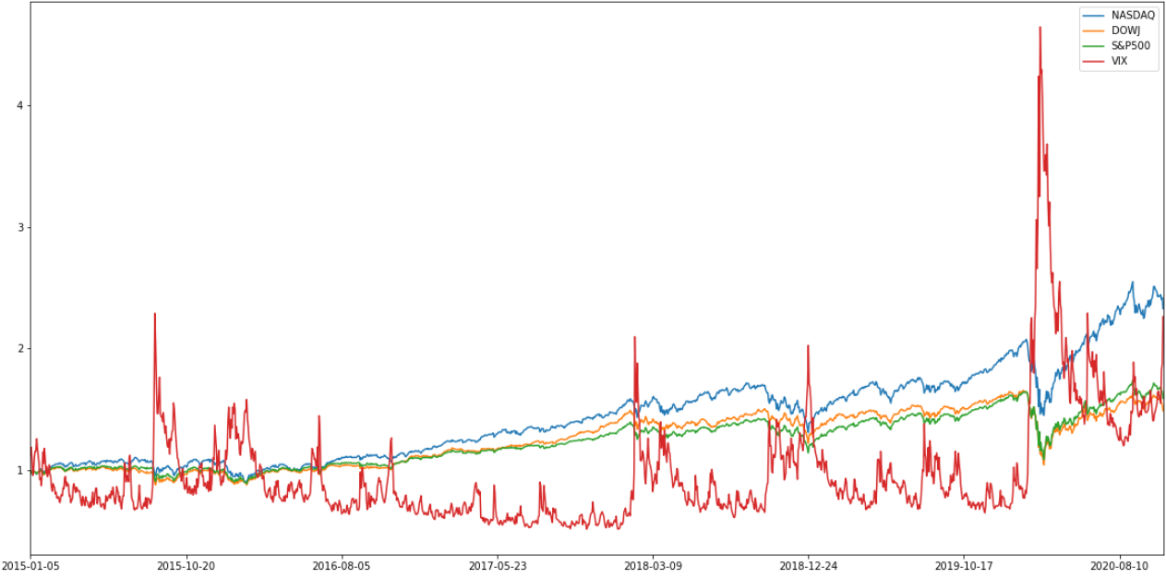

Indexes Cumulative Returns

Slide 10
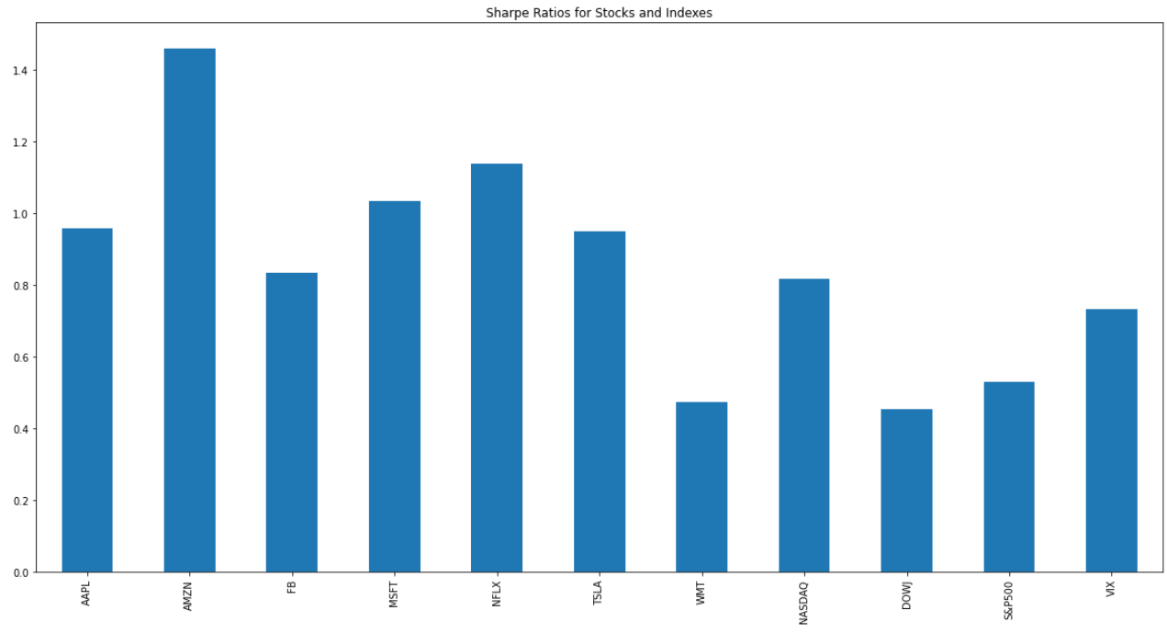
Sharp Ratios
AAPL | 0.959022
AMZN | 1.459217
FB | 0.835296
MSFT | 1.035596
NFLX | 1.139684
TSLA | 0.95032
WMT | 0.474141
NASDAQ | 0.818912
DOWJ | 0.453077
S&P500 | 0.530642
VIX | 0.733375

Slide 11

Five years investment plan
Monto Carlo simulation used to forecast five years investment of $10,000.00 with demo stock and s&p500 index to compare and plan for investment

Slide 12
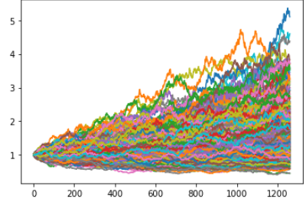
MC simulation
count | 500
mean | 1.634642
std | 0.705603
min | 0.448483
25% | 1.112938
50% | 1.550118
75% | 1.985046
max | 5.104571
95% CI Lower | 0.663683
95% CI Upper | 3.528633

Slide 13
Return forecast
Tickers | Investment | Possible Outcome Range 5 years |  | Median
AAPL | $ 10,000.00 | $ 10,004.70 | $ 298,604.74 | $ 59,327.97
AMZN | $ 10,000.00 | $ 10,477.99 | $ 273,193.83 | $ 56,612.16
FB | $ 10,000.00 | $ 11,848.36 | $ 311,151.86 | $ 61,871.02
MSFT | $ 10,000.00 | $ 11,258.54 | $ 379,069.00 | $ 57,754.40
NFLX | $ 10,000.00 | $ 10,873.09 | $ 293,479.23 | $ 56,723.59
TSLA | $ 10,000.00 | $ 10,652.62 | $ 301,150.17 | $ 57,424.57
WMT | $ 10,000.00 | $ 10,498.61 | $ 283,266.72 | $ 60,499.69

Slide 14
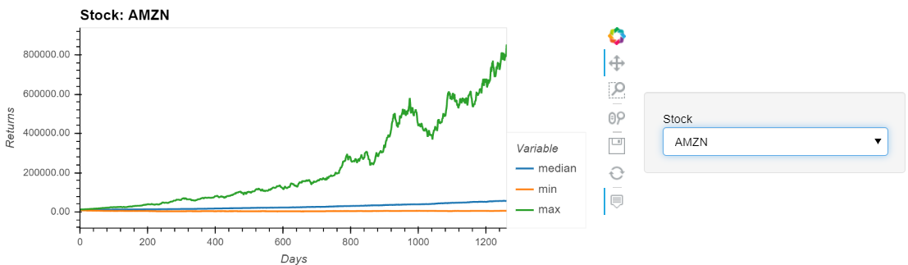
Panel demo

Slide 15



